Slide 1

So you want to learn bioinformatic huh?
By Jenna Robinson

Slide 2

Introduction
Outline
Command line basics
2. Quality over quantity: fastqc and adaptor trimming
3. Alignment (or finding where things belong)
4. Peak calling: ain’t no mountain high enough
5. Differential analysis
6. The rest of it: annotation, pathway enrichment and more ✨
Analysis code and useful resources can be found at:
https://github.com/jennarobinson99/MDA_bioinformatics
Get ready for a wild ride

Slide 3
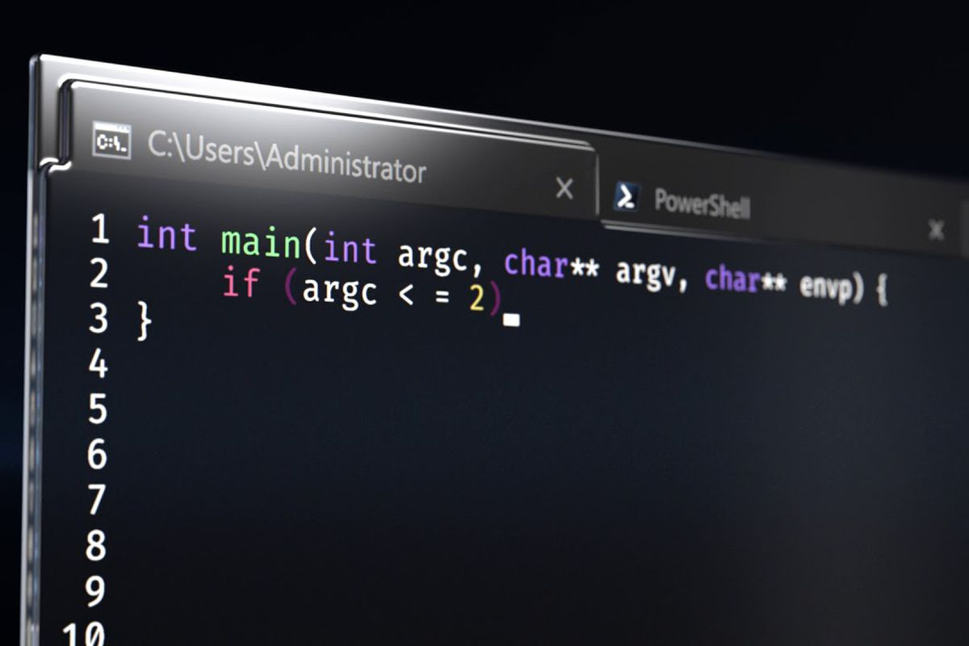

Command line basics
1.
Linux operating system
Terminal
Shell
Kernel
aka command line Where commands are typed
E.g. bash - command line interpreter
Performs the operation – dependent on computer hardware (e.g. RAM and CPU)
echo “hello world”
Computing server
Notes:
FYI you need to be connected to imperial wifi for this to work

Slide 4

Command line basics
1.
Downloading tools
Find your PATH – all the folders where the shell will search for a command
echo $PATH
To find if you have a particular tool
#NOTE - we use $ to define variables, in this case PATH is an environmental variable that tells the shell how to behave
#NOTE – do not confuse the uppercase PATH variable with the lowercase ‘path’ which defines your directory location
which fastqc
To install a new tools, use conda
module load fastqc
which fastqc
Notes:
Make directories
Ls
Cd
~ Home directory
Filezilla navigation

Slide 5
Command line basics
1.
Running batch jobs
Let’s start by making a job file that creates a next file called “test.txt” and prints numbers 123
echo “123” > test.txt
See github for how to make this a job script
vim test_job.pbs qsub test_job.pbs
qstat 6895378.pbs
Notes:
Example: add SRA toolkit
export PATH=$PATH:/data/seqtools/sratoolkit.2.8.2-1-centos_linux64/bin

Slide 6
Quality and Quantity
2.
Download files
To download fasta files, go to https://www.ebi.ac.uk/ena/browser/home and search SRR from sample sheet
Copy link address of “generated FASTQ files”
Download via wget e.g.
wget -O hacat_bg4_Rep1.fastq.gz ftp://ftp.sra.ebi.ac.uk/vol1/fastq/SRR309/000/SRR3095370/SRR3095370.fastq.gz
gunzip *.fastq

Slide 7
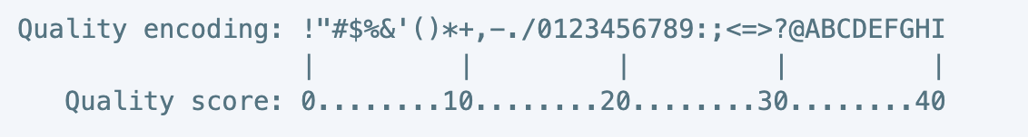
Quality and Quantity
2.
What’s in a fastq file?
Sequence ID
head hacat_bg4_Rep1.fastq
@SRR3095370.1 1/1
ACCTANTGAAGGATATCTTGGTTGCAGNTTTGNCAGTTATGAAN
+
AAA/A#<EAE/EEEEAE//EE//EEEE#EE/A#AAAE/EE/EE#
Sequence
Sequence quality score
Probability of incorrect base call is 1/P where P = 10^(Q/10)

Slide 8
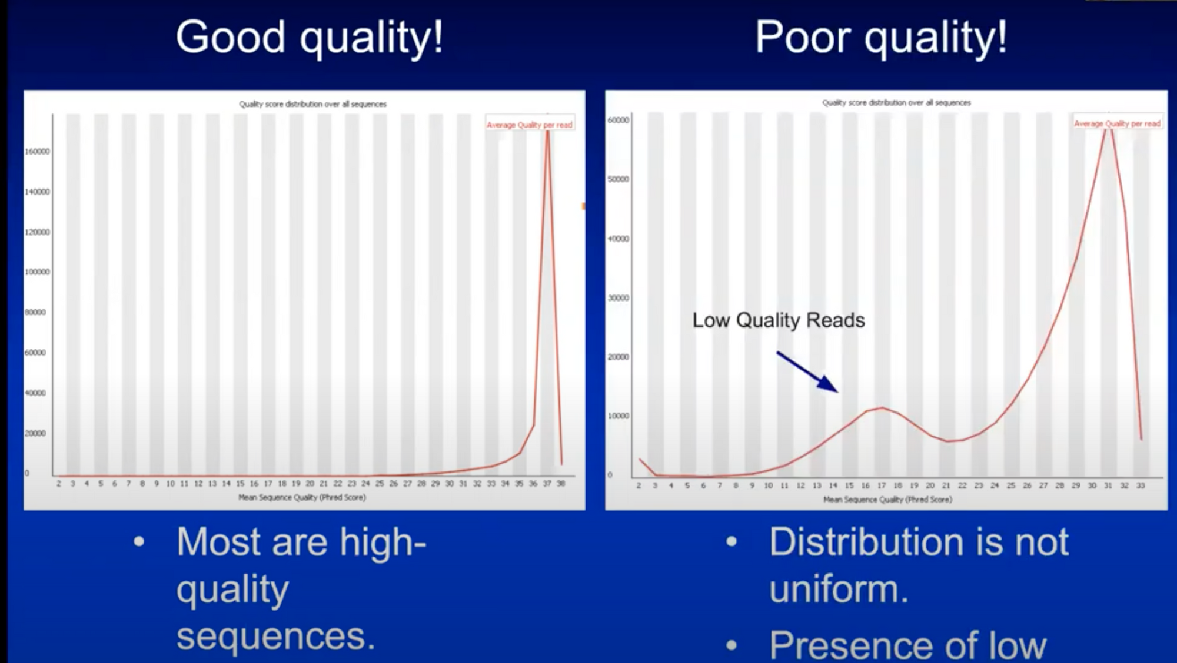
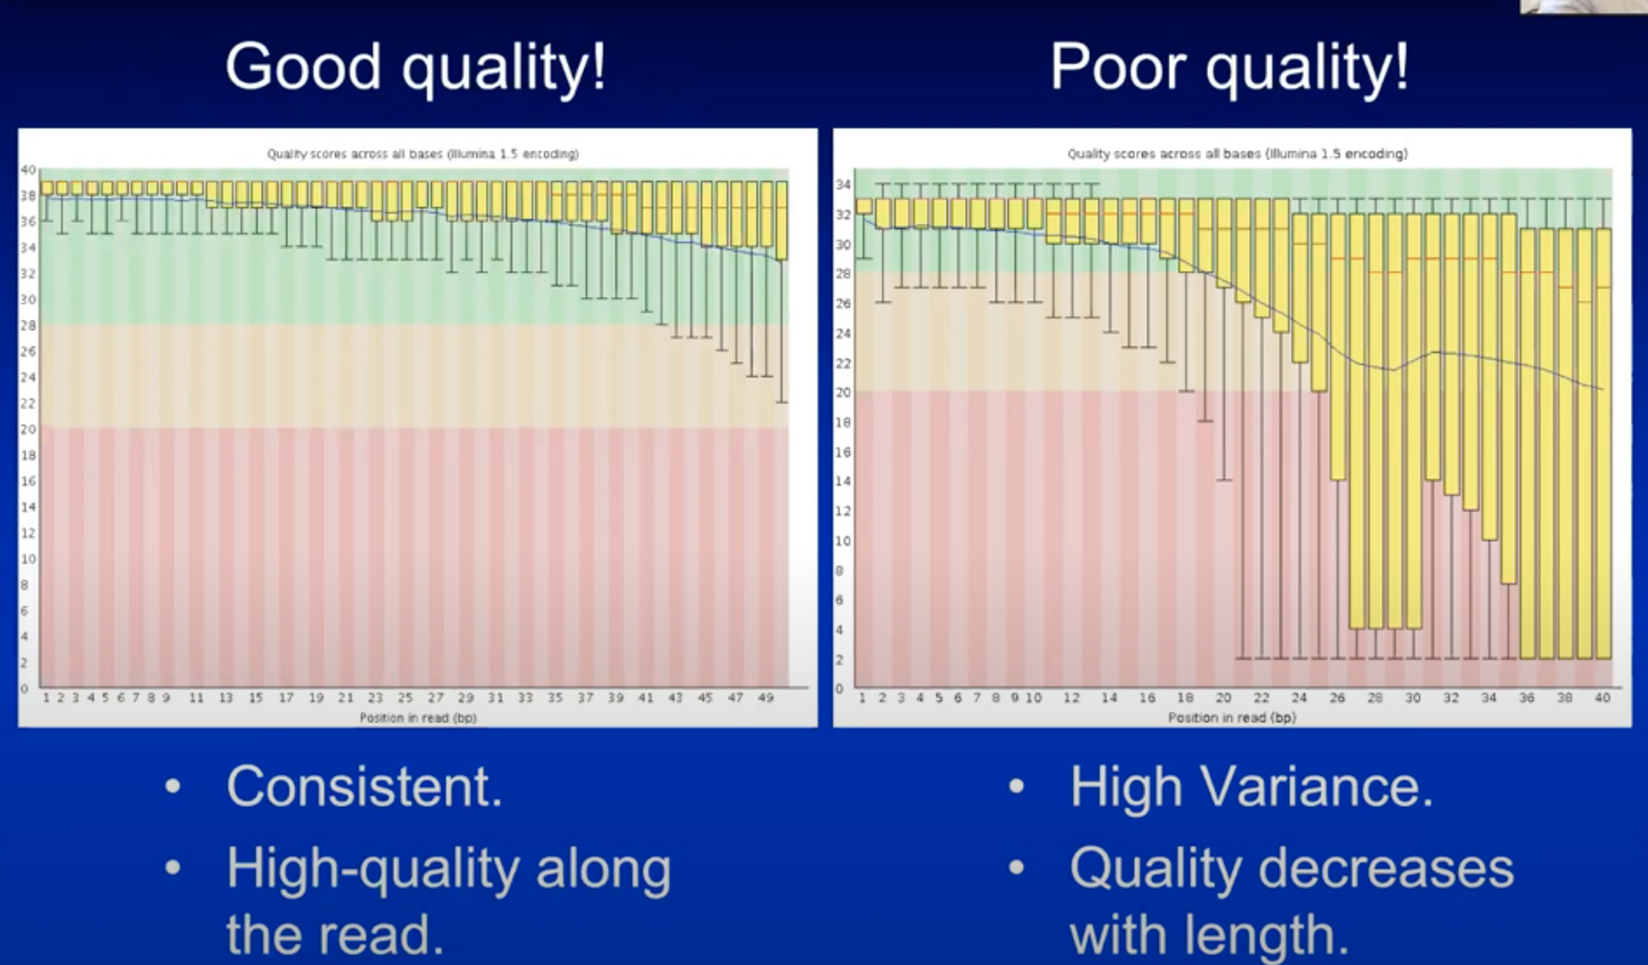
Quality and Quantity
2.
Assess quality with fastqc
#For single file
fastqc -t 12 file_name
#To batch multiple files
fastqc -t 12 *.fastq
Notes:
Recommended 30 million clean reads for BG4- ChIP

Slide 9
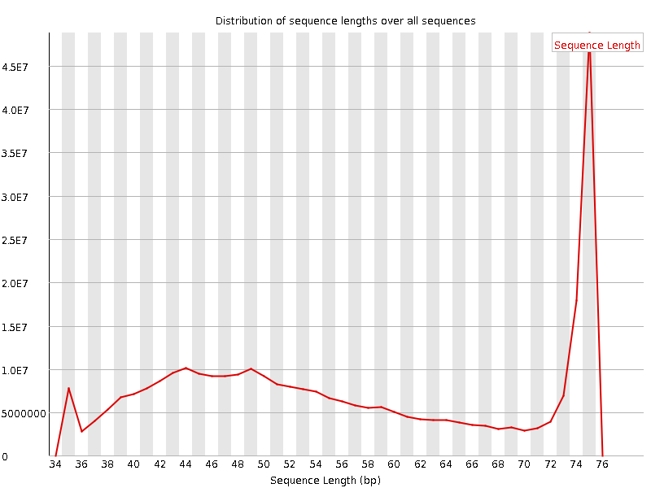
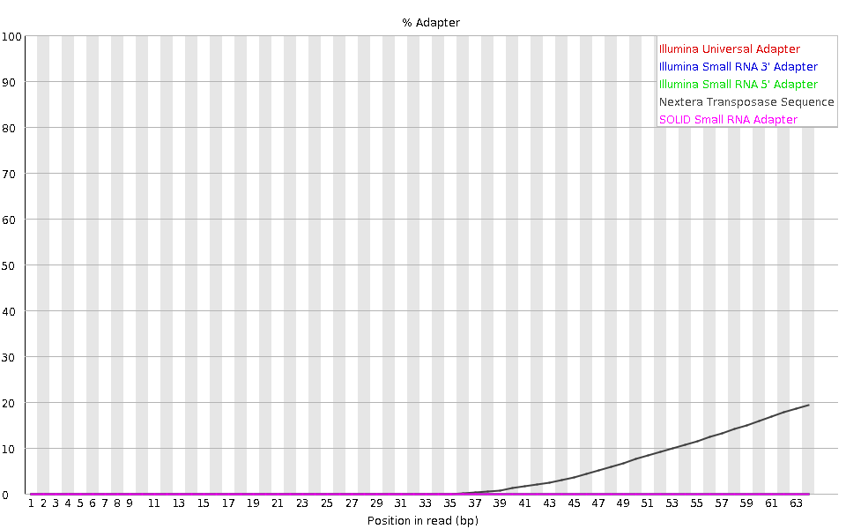
Quality and Quantity
2.
Inconsistent read length hacat_bg4_Rep1
Assess quality with fastqc
#For single file
fastqc -t 12 file_name
#To batch multiple files
fastqc -t 12 *.fastq
Sequencing of adaptors hacat_bg4_rep2_2
Notes:
Recommended 30 million clean reads for BG4- ChIP

Slide 10


Quality over Quantity
2.
Trim adaptors
If your sequence length is longer than your fragment length – you sequence some of your adaptors, which can reduce alignment quality
Cutadapt searches for and trims a specified adaptor sequence
#For single file
cutadapt -q 20 -a CTGTCTCTTATACACATCT file.fastq > file_trimmed.fastq 2> report_file.txt
# -q trims low-quality ends from reads, specify a cut-off point
# -a is the adaptor sequence to trim
# default settings for trimming are a maximum error rate of 0.1 and minimum overlap of 3 bp
#Automated code
for file in *.fastq
do
name=`basename $file .fastq`
echo starting $name
cutadapt -q 20 -a CTGTCTCTTATACACATCT $file > $name.trimmed.fastq 2> report_$name.txt echo $name done
done

Slide 11
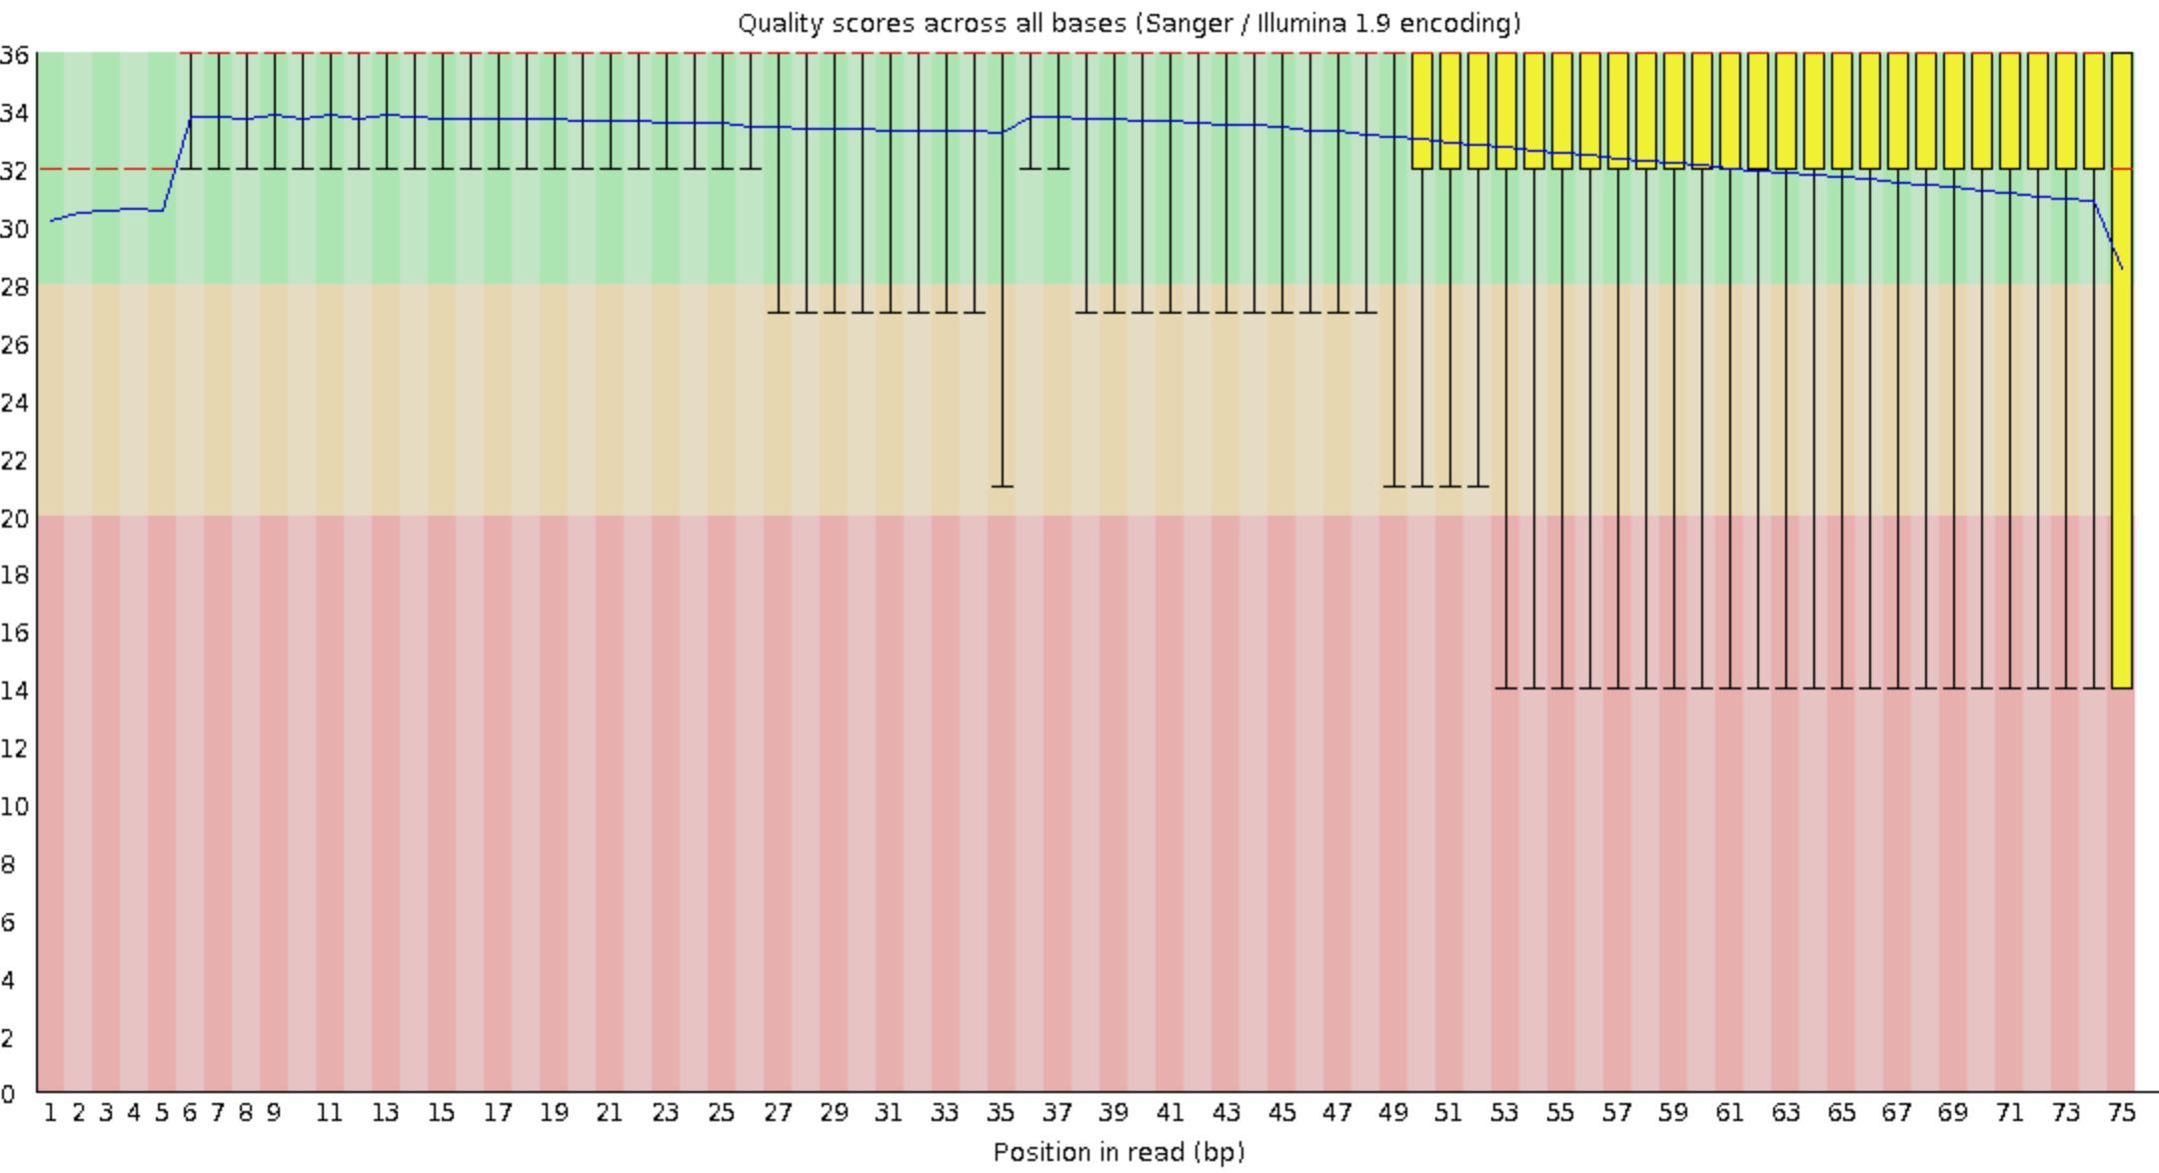
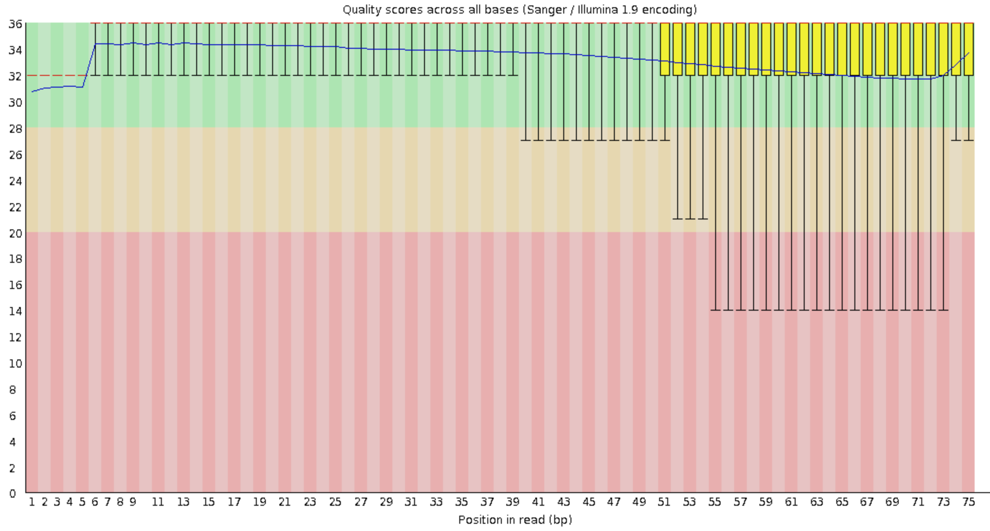
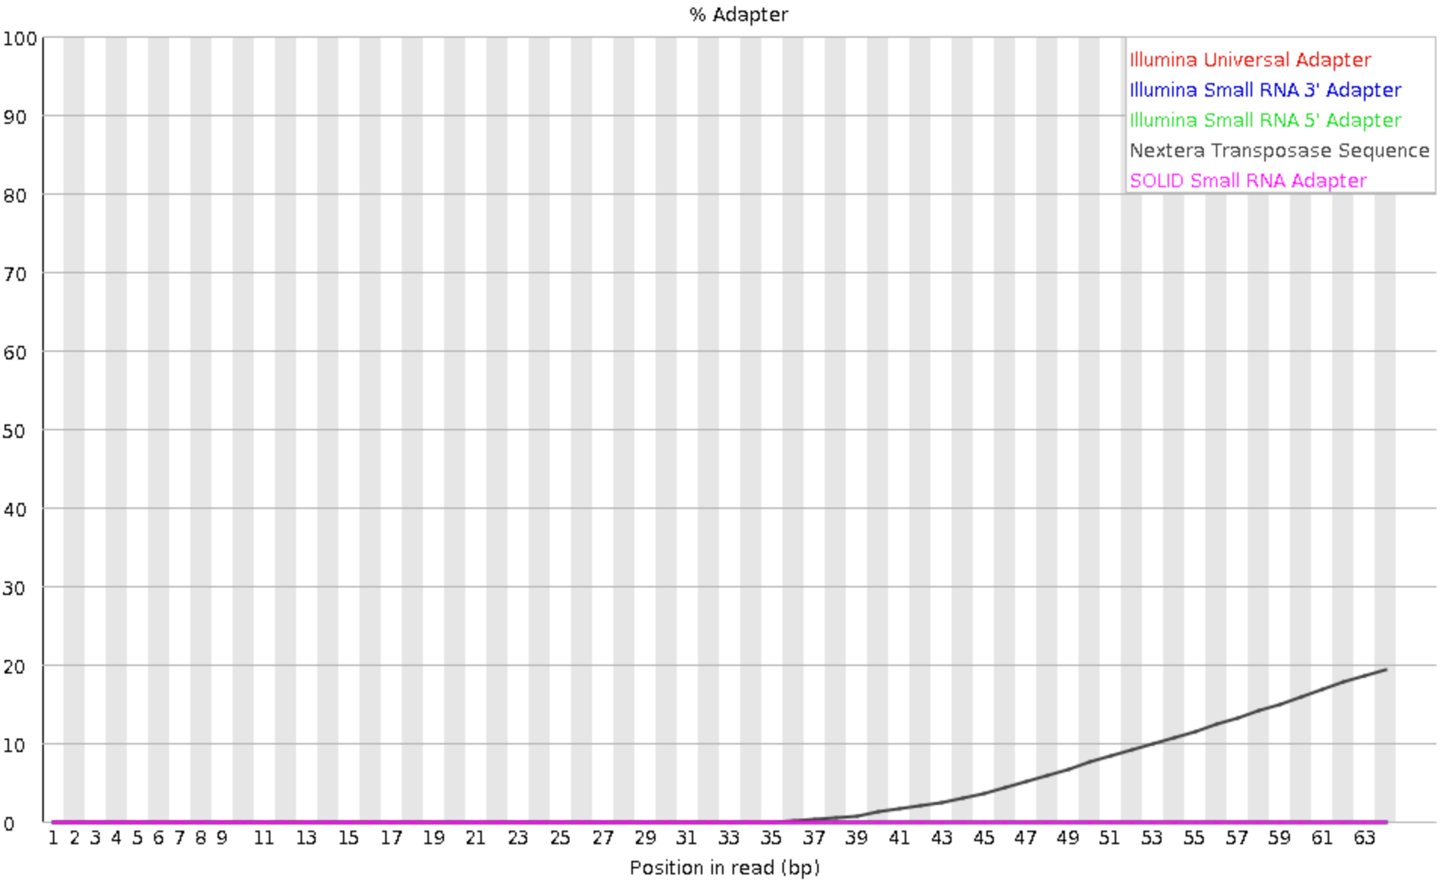
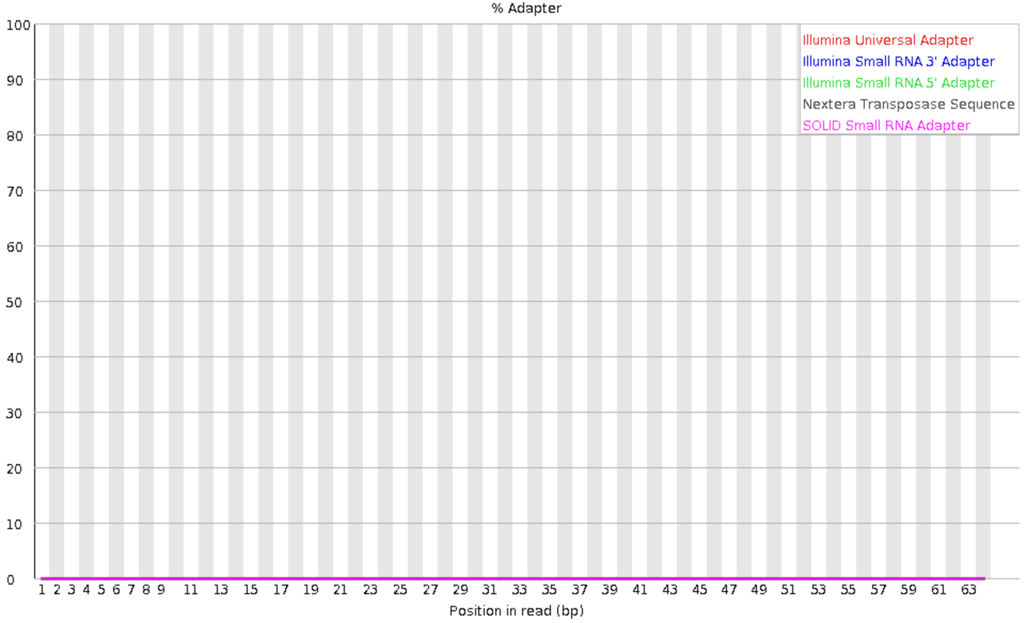
Quality over Quantity
2.
Before trimming
After trimming
Re-run fastqc
BG4_rep1
BG4_rep2_2

Slide 12
Aligning reads
3.
Install bowtie2

Slide 13
Aligning reads
3.
Download genomes and build indices

Slide 14
Aligning reads
3.
Merge technical replicates

Slide 15
Aligning reads
3.
Align reads

Slide 16
Aligning reads
3.
Sam file processing -> filter, sort, deduplicate, remove blacklisted regions, index

Slide 17
Peak calling
4.
Peak calling with MACS2

